Slide 1

Service Oriented Web Applications
(CS_SE_IT 2210)
Lesson 1
18 – March - 25
Bachelor of Information Technology
Department of Computing
Faculty of Computing and Technology
Saegis Campus
Nugegoda
Mrs. W.M.M.U.L Karunadasa
Saegis Campus

Slide 2
Introduction to Service-Oriented Programming and Web Services
Learning Objectives
Understand the concept of service-oriented programming.
Define web services and their types.
Explain the role of service-oriented architecture (SOA).
Identify key technologies behind web services.
Differentiate between SOAP and RESTful web services.
Explore real-world applications of web services.
Mrs. W.M.M.U.L Karunadasa
Saegis Campus

Slide 3
Introduction to Service-Oriented Programming
Service-Oriented Programming (SOP) focuses on building reusable software components.
These components, called services, interact through well-defined interfaces.
Services are independent and loosely coupled.
Example: An online store using separate services for payments, inventory, and shipping.
Mrs. W.M.M.U.L Karunadasa
Saegis Campus

Slide 4
Key Characteristics of Service-Oriented Programming
Loose Coupling - Services are independent.
Reusability - Services can be reused across applications.
Interoperability - Services can communicate despite platform/language differences.
Scalability - Supports distributed and large-scale applications.
Standardized Communication - Uses standardized protocols like HTTP, XML, and JSON.
Mrs. W.M.M.U.L Karunadasa
Saegis Campus

Slide 5
What are Web Services?
Web services allow communication between different applications over the internet.
Definition: A standardized way to integrate web-based applications.
Key Features:
  Uses HTTP/HTTPS for communication.
  Supports multiple data formats like XML and JSON.
  Accessible over a network (Internet or Intranet).
  Can be published and discovered dynamically.
Mrs. W.M.M.U.L Karunadasa
Saegis Campus

Slide 6
Components of a Web Service
Service Provider - The entity that creates and hosts the web service.
Service Consumer - The application or client that consumes the web service.
Service Registry - A directory where services can be published and discovered (e.g., UDDI - Universal Description, Discovery, and Integration).
Service Contract - A standardized agreement that defines how the service can be used, including input/output formats, operations, and endpoints (e.g., WSDL for SOAP services, OpenAPI for REST services).
Mrs. W.M.M.U.L Karunadasa
Saegis Campus

Slide 7
Types of Web Services
SOAP (Simple Object Access Protocol) - Uses XML-based messaging.
REST (Representational State Transfer) - Uses HTTP methods (GET, POST, PUT, DELETE).
GraphQL - A query language for APIs.
gRPC - A high-performance RPC framework.
Mrs. W.M.M.U.L Karunadasa
Saegis Campus

Slide 8
SOAP Web Services
SOAP (Simple Object Access Protocol): A protocol for exchanging structured information in web services using XML. It ensures secure and standardized communication between different systems over HTTP, SMTP, etc.
Protocol-based web service.
Uses XML for message formatting.
Operates over multiple transport protocols (HTTP, SMTP, TCP, etc.).
Provides built-in security features.
Example: Bank transactions and enterprise applications.
Mrs. W.M.M.U.L Karunadasa
Saegis Campus

Slide 9
RESTful Web Services
RESTful refers to web services that follow the REST (Representational State Transfer) architectural style.
RESTful services use HTTP methods (GET, POST, PUT, DELETE) to perform operations on resources, typically returning data in JSON or XML format. They are lightweight, scalable, and stateless, making them widely used in modern web applications.
Architectural style rather than a protocol.
Uses HTTP methods to perform operations.
Lightweight and faster compared to SOAP.
Example: Social media APIs like Facebook, Twitter, and Google.
Mrs. W.M.M.U.L Karunadasa
Saegis Campus

Slide 10
SOAP vs. REST - A Comparison
Feature | REST | SOAP
Protocol | HTTP | HTTP, SMTP, etc.
Format | JSON/XML | XML
Simplicity | Simple | Complex
Performance | Fast | Slower due to overhead
Security | Uses HTTPS | More robust security
Use Case | Web and mobile apps | Enterprise-level transactions
Mrs. W.M.M.U.L Karunadasa
Saegis Campus

Slide 11
Introduction to Service-Oriented Architecture (SOA)
SOP (Service-Oriented Programming): A programming approach where applications are built using reusable and independent services that communicate with each other over a network.
Services are loosely coupled, reusable, and independent.
Example: An e-commerce platform using separate services for payment, order processing, and inventory management.
Mrs. W.M.M.U.L Karunadasa
Saegis Campus

Slide 12
Benefits of SOA
Reusability - Services can be reused in different applications.
Interoperability - Works across different technologies.
Scalability - Can handle growing user demands.
Maintainability - Easier to update and manage.
Lecturer Name
Saegis Campus

Slide 13
Key Technologies Behind Web Services
XML (Extensible Markup Language) - Data format for SOAP.
JSON (JavaScript Object Notation) - Lightweight data format for REST.
WSDL (Web Services Description Language) - Describes web services.
UDDI (Universal Description, Discovery, and Integration) - Service directory.
HTTP/HTTPS - Communication protocols.
Lecturer Name
Saegis Campus

Slide 14
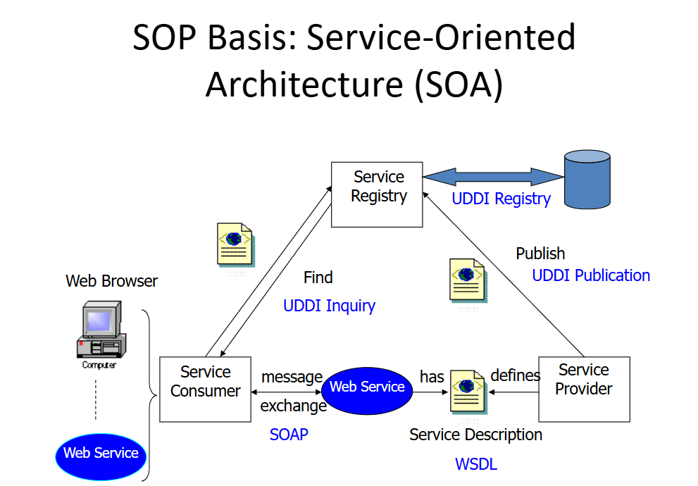
Lecturer Name
Saegis Campus

Slide 15
Real-World Applications of Web Services
E-Commerce: Payment gateways (PayPal API, Stripe API).
Social Media: Facebook Graph API, Twitter API.
Weather Forecasting: OpenWeatherMap API.
Cloud Services: AWS, Google Cloud APIs.
Lecturer Name
Saegis Campus

Slide 16
API Communication Examples
Scenario: Mobile app requests weather data from a web service.
Steps:
  User requests weather data.
  Web service processes the request.
  Web service responds with JSON/XML data.
Lecturer Name
Saegis Campus

Slide 17
Security in Web Services
Authentication: OAuth, API keys.
Encryption: HTTPS, SSL/TLS.
Data Validation: Prevent SQL injection, XSS attacks.
Rate Limiting: Prevent API abuse.
Lecturer Name
Saegis Campus

Slide 18
Performance Optimization for Web Services
Caching: Store frequent responses.
Load Balancing: Distribute traffic.
Compression: Use Gzip for data transfer.
Database Optimization: Indexing and query tuning.
Lecturer Name
Saegis Campus

Slide 19
Challenges in Implementing Web Services
Security Risks: Data breaches, unauthorized access.
Performance Issues: Slow response times due to network delays.
Compatibility: Different platforms and protocols.
Scalability: Handling increased user requests.
Maintenance: Keeping services updated and bug-free.
Lecturer Name
Saegis Campus

Slide 20
Case Study - Web Services in E-Commerce
Amazon API: Uses RESTful services to manage inventory and orders.
Supports multiple payment gateways.
Scalable architecture for high-traffic demand.
Lessons Learned: Efficient use of caching.
Security best practices.
Optimized API response times.
Lecturer Name
Saegis Campus

Slide 21
Future Trends in Web Services
AI-Driven APIs: Machine learning-based recommendations.
Serverless Architecture: AWS Lambda, Azure Functions.
Microservices Adoption: Breaking monolithic applications into services.
Blockchain Integration: Secure and transparent transactions.
5G and Edge Computing: Faster and more efficient web services.
Lecturer Name
Saegis Campus

Slide 22
Best Practices for Web Service Development
Use Versioning: Ensure backward compatibility.
Implement Error Handling: Standardized error messages.
Optimize Data Transfer: Reduce payload size.
Ensure Security: Use OAuth, JWT, and HTTPS.
Monitor and Log Requests: Track API usage and detect issues.
Lecturer Name
Saegis Campus

Slide 23
Hands-On Exercise
Task: Create a simple RESTful web service using a public API.
Steps:
  Choose an API (e.g., OpenWeather, GitHub, JSONPlaceholder).
  Send a GET request using Postman.
  Parse the JSON response.
  Display the results in a simple application.
Lecturer Name
Saegis Campus

Slide 24
Summary of the Lecture
Service-Oriented Programming enables modular and reusable service components.
Web Services facilitate communication between applications.
SOAP vs. REST: REST is lightweight and widely used; SOAP is secure and reliable.
SOA ensures scalable and maintainable service-based applications
Security & Performance are key concerns in service development.
Future Trends: AI, microservices, blockchain, and serverless computing.
Lecturer Name
Saegis Campus

Slide 25

Q&A Session
Lecturer Name
Saegis Campus
Lecturer Name
Saegis Campus

